Slide 1
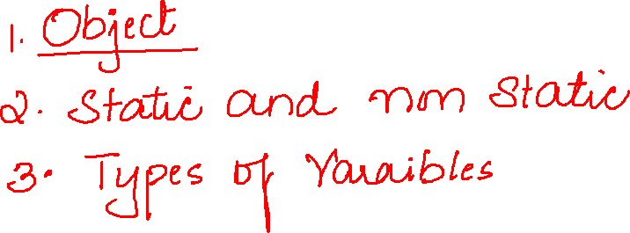

Slide 2
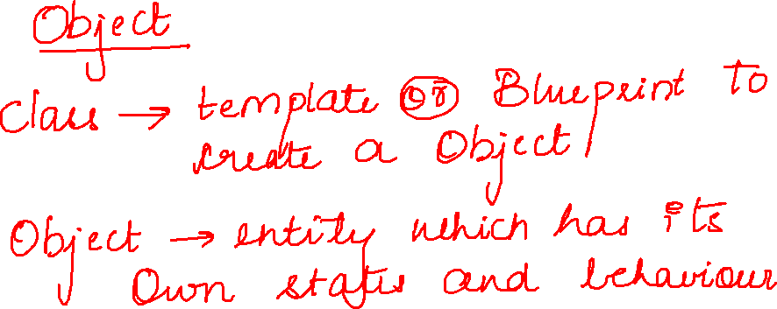

Slide 3
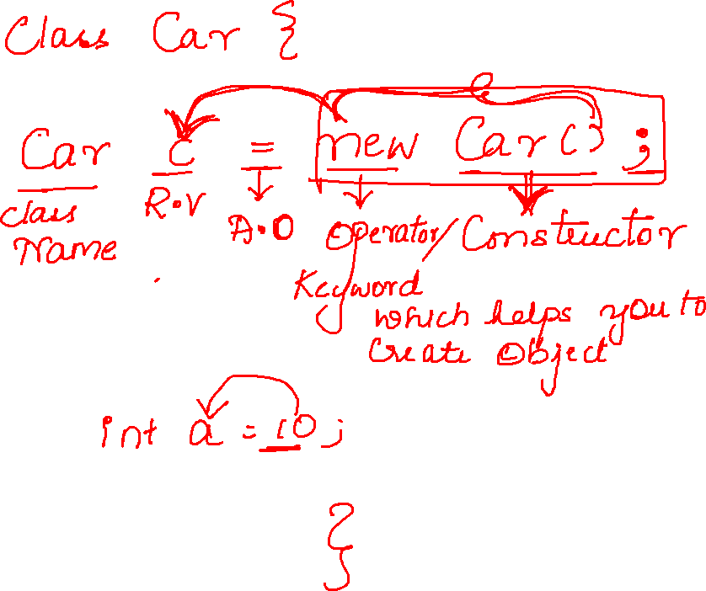

Slide 4
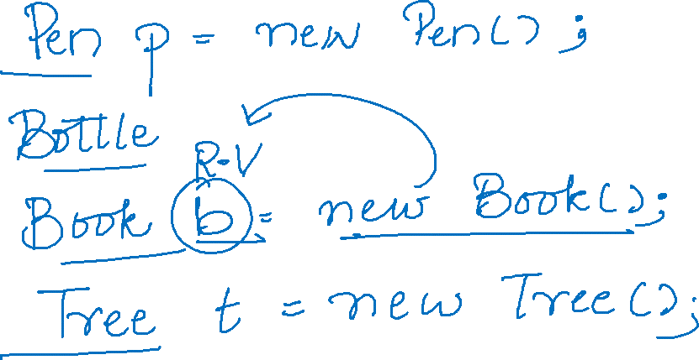

Slide 5
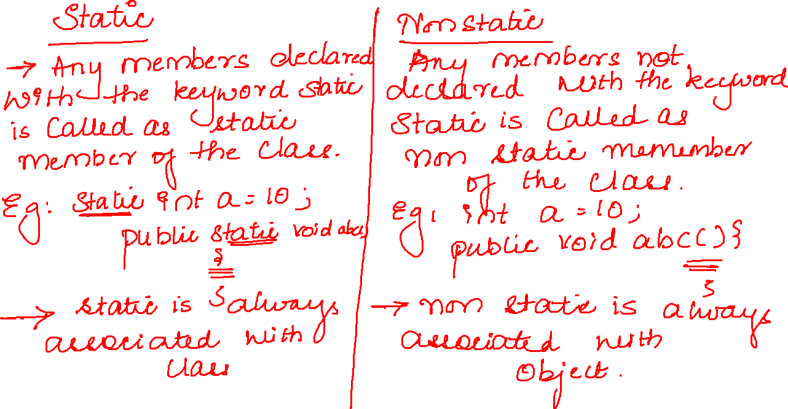

Slide 6
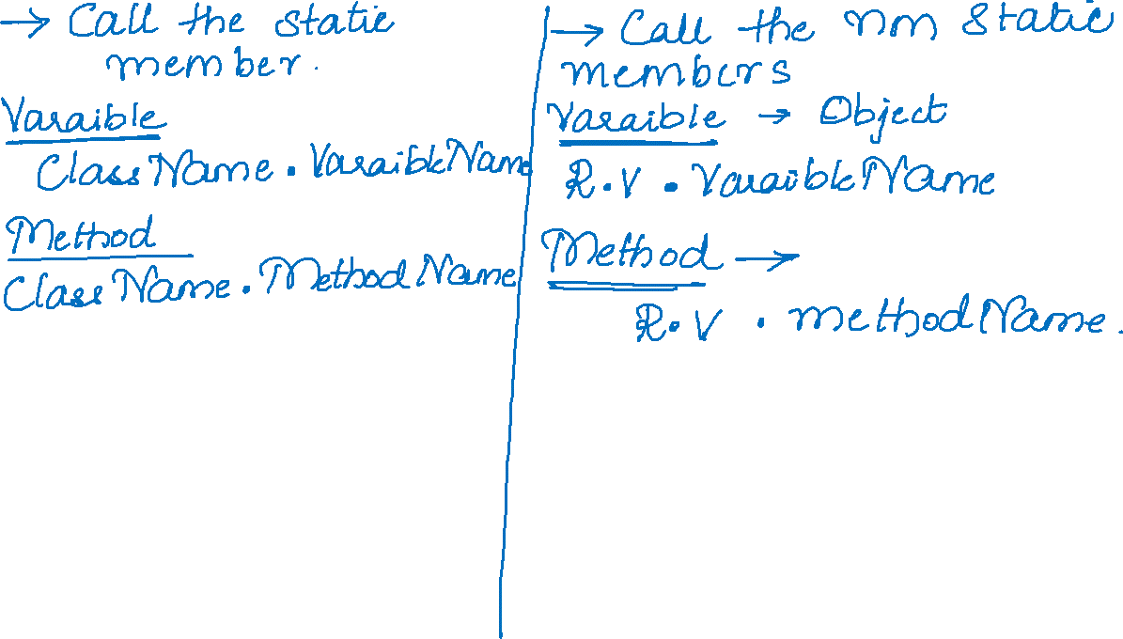
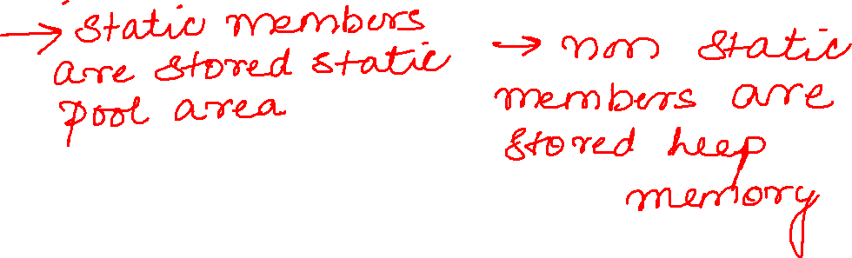

Slide 7
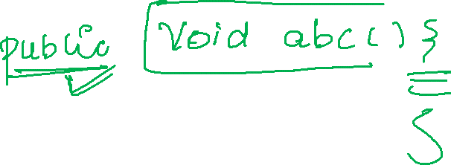

Slide 8

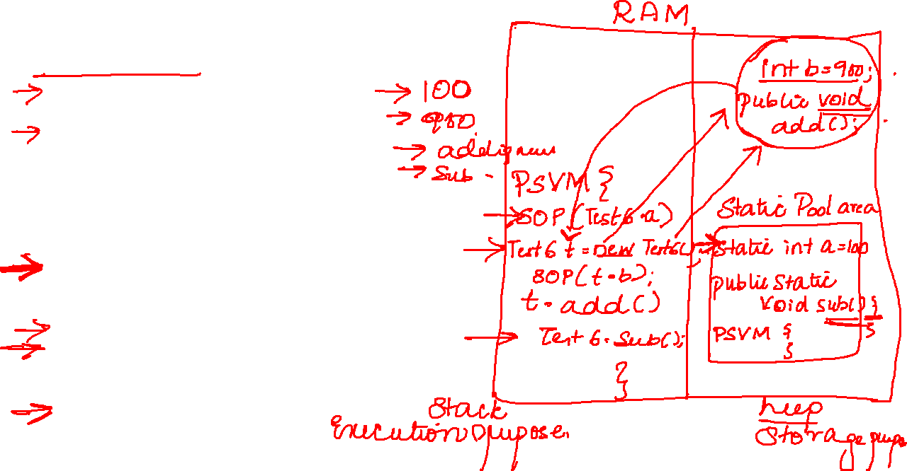
public class Test6 {
static int a=100;
int b=900;
public void add() {
System.out.println("adding numbers");
}
public static void sub() {
System.out.println("subtracting numbers");
}
public static void main(String[] args) {
System.out.println(Test6.a);
Test6 t=new Test6();
System.out.println(t.b);
t.add();
Test6.sub();
}
}

